Slide 1
Chapter 8
Dielectric constant of a plasma
A neutral gas of charged particles is called a plasma.
Metals, doped semiconductors and ionized gases can be treated as single component plasmas in which ions are immobile and charge carriers are free to move. In metals, charge carriers come from valence electrons, in semiconductors, mostly from donors (n-type) or acceptors (p-type)
Two-component plasmas are ones where both positive and negative charges are on mobile particles e.g. the extremely hot deuterium and tritium plasmas in a fusion reactor, where there are both both free ions and electrons with very different plasma frequencies.

Slide 2
Chapter 8
Take the case of free electrons in a metal as an example. Let’s work out the dielectric constant. The equation of motion of a single electron is
where ϒ is the damping rate (note: no restoring force because the electron is free). This is the same equation as for the Lorentz
oscillator with χ_{b}=0, ω_{o}=0).
Hence
(the plasma frequency)

Slide 3
Chapter 8
It is usual to replace the damping rate by the inverse electron scattering
time,
Real and imaginary parts are:
From and we can find n and using the standard equations – and hence the absorption coefficient and reflectivity.

Slide 4
Chapter 8
Relationship between dielectric constant and conductivity
In the Drude model the DC electrical conductivity is
and the AC or ‘optical’ conductivity is
N is the number of free electrons per unit volume and τ is the momentum scattering time.
For metals and highly doped semiconductors ~ 10⁻¹⁴-10⁻¹³ s so that doesn’t vary much from the static value until frequency is in the infrared.
Comparison of previous expressions for with that for shows that

Slide 5
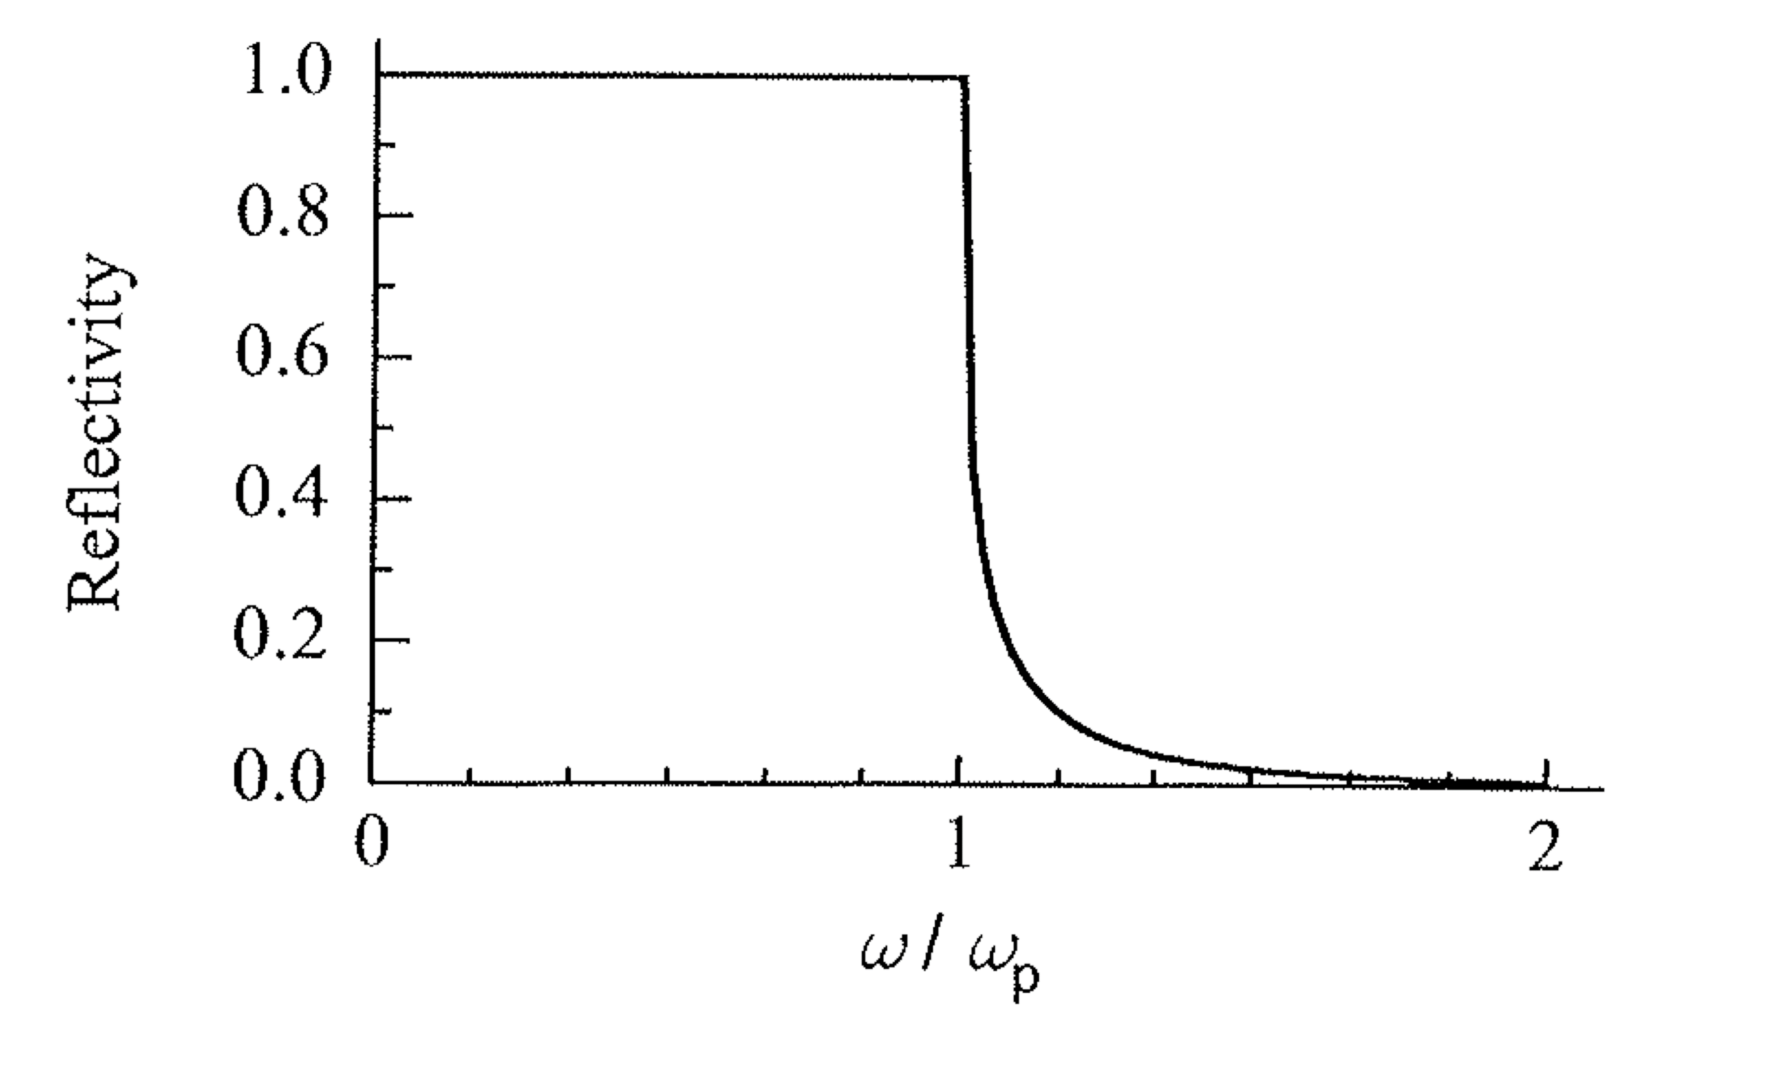
Chapter 8
Undamped plasma reflectivity
is plotted in the figure
If then is negative and is purely imaginary so that n=0.
Reflectivity is
If then is positive and is real so that R<1.

Slide 6
Chapter 8
If electrons can move fast enough to screen optical field, which hardly penetrates the surface even when including damping. Reflectivity is high.
If field penetrates significantly - more loss and lower reflectivity. Electrons cannot move fast enough to screen the optical field.
In metals plasma frequency is in range 1-5 x 10¹⁵ Hz (4-20 eV) and they become transparent in the deep UV.

Slide 7
Low frequency reflectivity with damping
Chapter 8
For metals at very low frequencies (e.g. microwave and far infrared) where
Recall that in this strongly absorbing limit:
(and both are >>1)

Slide 8
Chapter 8
Reflectivity (normal incidence)
Using results from 7.2
Hagen-Rubens
relation for infrared
reflectivity of metals

Slide 9
Chapter 8
Absorption coefficient
Skin depth
Field strength in a conductor decays exponentially from surface as
At higher frequencies, when is no longer true, approximations
break down, as is the case for near infrared absorption due to free carriers
In semiconductors (lecture 8).

Slide 10
Chapter 8
Reflectivity of real metals
For aluminium (see diagram),
Prediction of plasma frequency
edge is roughly correct
Agreement can be improved
by using m* rather than m_{o} to
calculate .
The reflectivity is less than
100% below ; adding
damping only has a small effect.
The main reduction in reflectivity
is due to interband transitions
with onset at 1.5 eV.
Reflectivity tends to 1.0 below
1.5 eV (no interband transitions there).

Slide 11
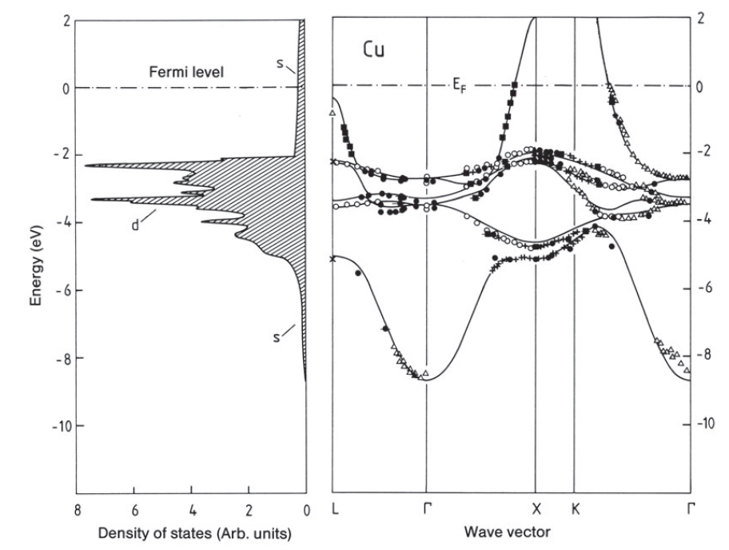
Chapter 8
Interband absorption in metals
Light penetrates only a short way into the surface of a good conductor (remember the skin depth).
Interband transitions can cause absorption of light that has penetrated
the surface. The reflectivity then falls below 1 when .
e.g. COPPER
The 11 valence electrons of Cu fill up the 3d band and half fill the 4s band.
The Fermi energy lies within the 4s band. An optical transition can excite an electron from an occupied state to an empty state at or above the Fermi level.

Slide 12
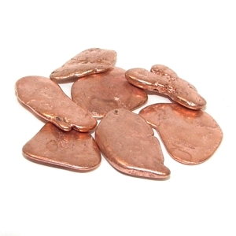
Chapter 8
The plasma frequency corresponds to an energy of 10.8 eV but, between 2 and 10 eV, the optical properties are dominated by the effect of interband transitions.

Slide 13
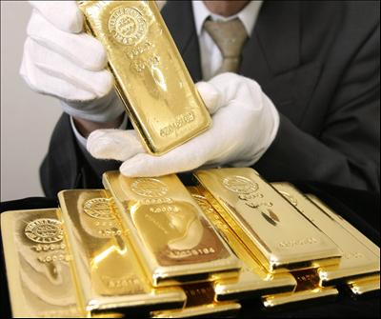
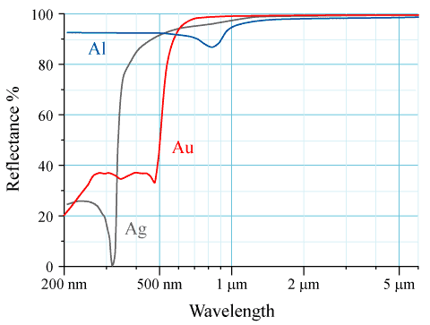
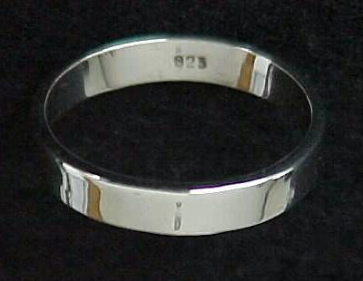
Chapter 8
GOLD: the interband absorption threshold between the d bands and the Fermi level occurs at 2.4 eV, (516 nm), a slightly higher energy than copper. Plasma edge is at 9 eV. Gold reflects red, orange and yellow light more than green and blue. This accounts for its characteristic yellowish colour.
SILVER: The interband absorption edge is in the UV at ~4eV. The reflectivity remains high for the entire visible spectrum, accounting for its silver colour and use in high quality mirrors.

Slide 14
Chapter 8
Doped semiconductors
Modifications to Drude-Lorentz model :
The effective mass of the carriers i.e. m_{o} is replaced by m* in expression for .
The background permittivity of the semiconductor lattice is large and must be replaced by where is value of in the transparent region below the interband absorption edge in the undoped material.
Plasma frequency is therefore modified.
Plasma frequency depends on doping:
N/m³
The plasma reflectivity edge is in the mid- to far-infrared where most intrinsic semiconductors are transparent.

Slide 15
Chapter 8
Plasma oscillations
In a medium with no net charge, Gauss’s law states that:
Consider a wave solution of the form
Substituting E into Gauss’s law we find that
i.e. the waves are transverse.
But, if then need not be zero – the material can then support
longitudinal electromagnetic waves.

Slide 16
Chapter 8
We have seen that for an undamped system of free electrons,
at the plasma frequency so that we can have longitudinal EM waves at .
Low electron density
High electron density
These waves are associated with collective
longitudinal oscillations of the electrons relative
to the background of the positive ion lattice
and are called bulk or volume plasmons.
Light in vacuum is transverse – so cannot directly
excite bulk plasmons with photons.
E
x

Slide 17
Chapter 8
The plasma frequency is therefore both the frequency above which conductors become transparent
and
the natural oscillation frequency of the electron gas relative to the ion cores.

